Slide 1
A common neural basis for contrast and motion coherence perception
Dan Birman
Gardner Lab
Frisem 2017-06-26

Slide 4
Contrast

Slide 5
Coherence

Slide 6
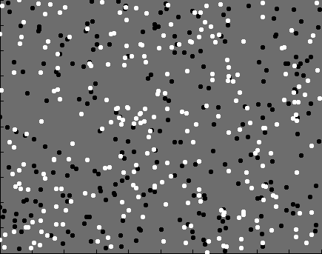

Slide 7
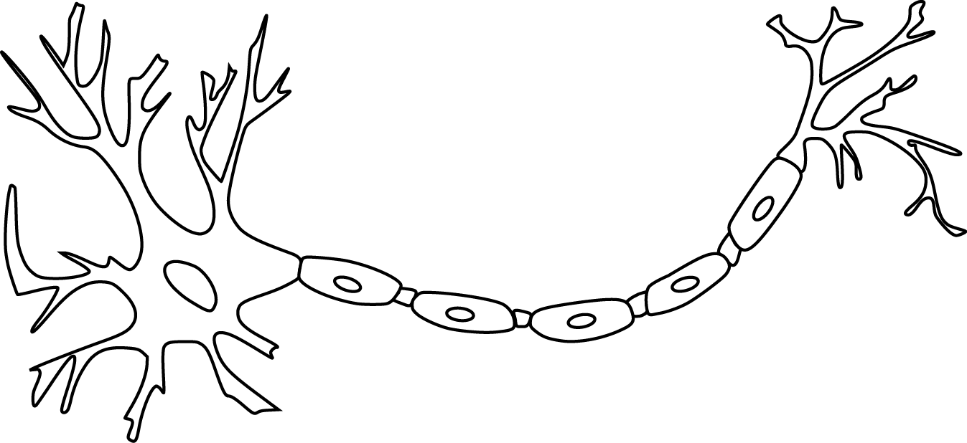

Slide 9
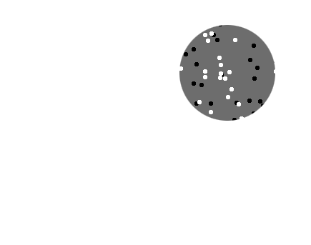
Receptive field

Slide 10
Receptive field

Slide 11
Receptive field

Slide 12
Population
Receptive field

Slide 14
~ 2.5 mm
~ 2.5 mm
~ 2.5 mm

Slide 15
~ 2.5 mm
~ 2.5 mm
~ 2.5 mm
Lots of neurons (10^6-7)

Slide 17
Perception is linked to population representations

Slide 18
Perception is linked to population representations
Model of population representations

Slide 19
Perception is linked to population representations
Model of population representations
Directly linked to behavior

Slide 20
Perception is linked to population representations
Model of population representations
Directly linked to behavior

Slide 21
Perception is linked to population representations
Model of population representations
Directly linked to behavior

Slide 22
Representation of contrast?
Boynton et al. 1999

Slide 23
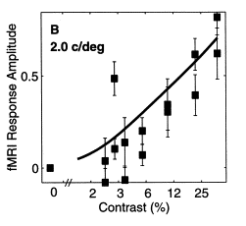
Representation of contrast?
Boynton et al. 1999

Slide 24
Representation of contrast?
Boynton et al. 1999
Representation of coherence?
Rees and Koch 2000

Slide 25
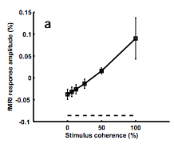
Representation of contrast?
Boynton et al. 1999
Representation of coherence?
Rees and Koch 2000

Slide 26
Representation of contrast?
Boynton et al. 1999
Representation of coherence?
Rees and Koch 2000

Slide 27
Goal: A model of how voxels represent (encode) contrast and motion coherence

Slide 28
Goal: A model of how voxels represent (encode) contrast and motion coherence
Shape: From cortical measurements of BOLD fMRI
Prediction and comparison to a behavioral measure of visibility

Slide 29
Goal: A model of how voxels represent (encode) contrast and motion coherence
Shape: From cortical measurements of BOLD fMRI
Noise: From a behavioral measure of visibility

Slide 30
Goal: A model of how voxels represent (encode) contrast and motion coherence
Shape: From cortical measurements of BOLD fMRI
Noise: From a behavioral measure of visibility

Slide 34
Luminance changes = bad

Slide 39
Cortical measurements

Slide 40
Cortical measurements
11 observers, asynchronous task at fixation
800+ trials (20 per experimental condition)
1 hr retinotopy
4 x 2 hr scanning sessions

Slide 41
Area V1
Area MT

Slide 43
Within-subject analysis: display average across subjects

Slide 44
Within-subject analysis: display average across subjects
Timecourses were averaged within ROIs

Slide 45
Within-subject analysis: display average across subjects
Timecourses were averaged within ROIs
Deconvolution (GLM/finite impulse response) used to obtain separated per-condition measurements

Slide 47
Contrast

Slide 48
Contrast

Slide 49
Contrast

Slide 50
Contrast
Coherence

Slide 51
Contrast
Stimulus length
Coherence

Slide 68
Contrast

Slide 69
Contrast
Coherence

Slide 70
Contrast
Stimulus length
Coherence

Slide 73
Neural response model for cortical measurements

Slide 82
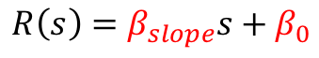
$$R\left(s\right)=β_{slope}s+β_{0}$$
Feature strength

Slide 83

$$R\left(s\right)=β_{slope}s+β_{0}$$
$$R\left(s\right)=α\frac{s^{p+q}}{s^{q}+c_{50}^{q}}+β_{0}$$
Feature strength

Slide 84
$$R\left(s\right)=β_{slope}s+β_{0}$$
$$R\left(s\right)=α\frac{s^{p+q}}{s^{q}+c_{50}^{q}}+β_{0}$$
Feature strength

Slide 86

$${\left(\frac{t}{τ}\right)}^{n−1}ε^{−\frac{t}{τ}}∗τ\left(n−1\right)!$$

Slide 87

$${\frac{l_{trial}}{l_{500}}}^{−κ}$$

Slide 108
Is the motion coherence response linear?

Slide 109
Is the motion coherence response linear?

Slide 110
Is the motion coherence response linear?

Slide 111
Is the motion coherence response linear?

Slide 112
Is the motion coherence response linear?

Slide 113
Is the motion coherence response linear?

Slide 114
Is the motion coherence response linear?

Slide 115
Is the motion coherence response linear?

Slide 116
Goal: A model of how voxels represent (encode) contrast and motion coherence
Shape: From cortical measurements of BOLD fMRI
Noise: From a behavioral measure of visibility

Slide 117
Goal: A model of how voxels represent (encode) contrast and motion coherence
Shape: From cortical measurements of BOLD fMRI
Noise: From a behavioral measure of visibility

Slide 118
Goal: A model of how voxels represent (encode) contrast and motion coherence
Shape: From cortical measurements of BOLD fMRI
Evidence for similar nonlinear (Naka-Rushton) response functions to contrast and motion coherence
Noise: From a behavioral measure of visibility

Slide 119
Goal: A model of how voxels represent (encode) contrast and motion coherence
Shape: From cortical measurements of BOLD fMRI
Evidence for similar nonlinear (Naka-Rushton) response functions to contrast and motion coherence
Noise: From a behavioral measure of visibility

Slide 122
11 fMRI observers, 21 behavioral observers (1000—2500 trials)

Slide 145
Neural response model for behavioral measurements

Slide 149

$$r_{trial}=β_{con}R\left(Δs_{con}\right)+β_{coh}R\left(Δs_{coh}\right)+β_{bias}$$

Slide 151
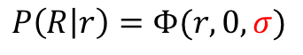
$$P\left(R | r\right)=Φ(r,0,σ)$$

Slide 152
Smaller sigma
(less noise)
$$P\left(R | r\right)=Φ(r,0,σ)$$

Slide 153

$$d^{′}=\frac{response}{noise}$$
Smaller sigma
(less noise)

Slide 154
Is noise additive or Poisson?

Slide 155
Is noise additive or Poisson?

Slide 156
Is noise additive or Poisson?

Slide 157
Is noise additive or Poisson?

Slide 158
Is noise additive or Poisson?

Slide 159
Is noise additive or Poisson?

Slide 160
Is noise additive or Poisson?

Slide 161
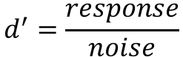
Response amplitude (s.d.)
Stimulus strength (%)
Stimulus strength (%)
$$d^{′}=\frac{response}{noise}$$

Slide 162
Response amplitude (s.d.)
Stimulus strength (%)
Stimulus strength (%)
$$d^{′}=\frac{response}{noise}$$

Slide 163
Response amplitude (s.d.)
Stimulus strength (%)
Stimulus strength (%)
$$d^{′}=\frac{response}{noise}$$

Slide 164
Response amplitude (s.d.)
Stimulus strength (%)
Stimulus strength (%)

Slide 165
Response amplitude (s.d.)
Stimulus strength (%)
Stimulus strength (%)

Slide 166
Additive noise

Slide 167
Additive noise

Slide 168
Poisson noise

Slide 169
Poisson noise

Slide 170
Poisson noise

Slide 171
Is the underlying noise additive or Poisson?

Slide 172
Is the underlying noise additive or Poisson?

Slide 173
Is the underlying noise additive or Poisson?

Slide 174
Is the underlying noise additive or Poisson?

Slide 175
Goal: A model of how voxels represent (encode) contrast and motion coherence
Shape: From cortical measurements of BOLD fMRI
Noise: From a behavioral measure of visibility

Slide 176
Goal: A model of how voxels represent (encode) contrast and motion coherence
Shape: From cortical measurements of BOLD fMRI
Noise: From a behavioral measure of visibility

Slide 177
Goal: A model of how voxels represent (encode) contrast and motion coherence
Shape: From cortical measurements of BOLD fMRI
Evidence for similar nonlinear (Naka-Rushton) response functions to contrast and motion coherence
Noise: From a behavioral measure of visibility

Slide 178
Goal: A model of how voxels represent (encode) contrast and motion coherence
Shape: From cortical measurements of BOLD fMRI
Evidence for similar nonlinear (Naka-Rushton) response functions to contrast and motion coherence
Noise: From a behavioral measure of visibility

Slide 179
Goal: A model of how voxels represent (encode) contrast and motion coherence
Shape: From cortical measurements of BOLD fMRI
Evidence for similar nonlinear (Naka-Rushton) response functions to contrast and motion coherence
Noise: From a behavioral measure of visibility
Judgments of contrast and motion coherence appear to be read out under additive noise

Slide 180
Goal: A joint model of how voxels represent (encode) contrast and motion coherence constrained on fMRI and behavior
Shape: From cortical measurements of BOLD fMRI
Evidence for similar nonlinear (Naka-Rushton) response functions to contrast and motion coherence
Noise: From a behavioral measure of visibility
Judgments of contrast and motion coherence appear to be read out under additive noise

Slide 181
Goal: A joint model of how voxels represent (encode) contrast and motion coherence constrained on fMRI and behavior
Shape: From cortical measurements of BOLD fMRI
Evidence for similar nonlinear (Naka-Rushton) response functions to contrast and motion coherence
Noise: From a behavioral measure of visibility
Judgments of contrast and motion coherence appear to be read out under additive noise

Slide 182
Goal: A joint model of how voxels represent (encode) contrast and motion coherence constrained on fMRI and behavior
Shape: From cortical measurements of BOLD fMRI
Evidence for similar nonlinear (Naka-Rushton) response functions to contrast and motion coherence
Noise: From a behavioral measure of visibility
Judgments of contrast and motion coherence appear to be read out under additive noise

Slide 183
Goal: A joint model of how voxels represent (encode) contrast and motion coherence constrained on fMRI and behavior
Shape: From cortical measurements of BOLD fMRI
Evidence for similar nonlinear (Naka-Rushton) response functions to contrast and motion coherence
Noise: From a behavioral measure of visibility
Judgments of contrast and motion coherence appear to be read out under additive noise

Slide 184

Thanks!
Another person involved in this project:
Justin Gardner

